Slide 1
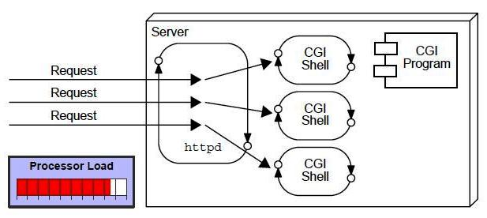
What is web application?
A web application is an application accessible from the web. A web application is composed of web components like Servlet, JSP, Filter etc. and other components such as HTML. The web components typically execute in Web Server and respond to HTTP request.
Earlier Avatar: CGI(Common Gateway Interface)
CGI technology enables the web server to call an external program and pass HTTP request information to the external program to process the request. For each request, it starts a new process.
Disadvantages of CGI
There are many problems in CGI technology:
If number of clients increases, it takes more time for sending response.
For each request, it starts a process and Web server is limited to start processes.
It uses platform dependent language e.g. C, C++, Perl.

Slide 2
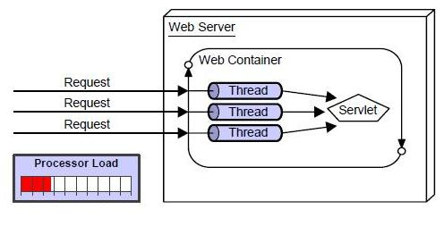
Advantage of Servlet
There are many advantages of servlet over CGI. The web container creates threads for handling the multiple requests to the servlet. Threads have a lot of benefits over the Processes such as they share a common memory area, lightweight, cost of communication between the threads are low. The basic benefits of servlet are as follows:
better performance: because it creates a thread for each request not process.
Portability: because it uses java language.
Robust: Servlets are managed by JVM so we don't need to worry about memory leak, garbage collection etc.
Secure: because it uses java language..

Slide 3
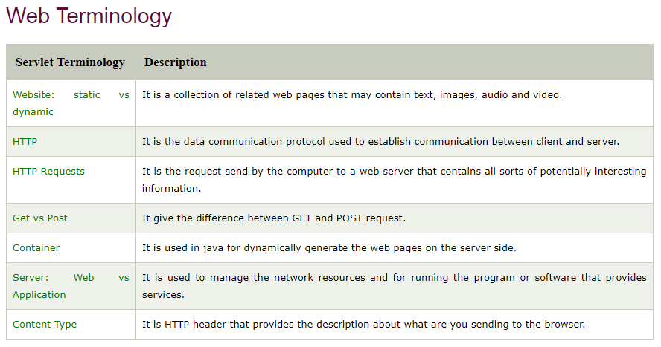

Slide 4
What is a Website?
Website is a collection of related web pages that may contain text, images, audio and video. The first page of a website is called home page. Each website has specific internet address (URL) that you need to enter in your browser to access a website.
Website is hosted on one or more servers and can be accessed by visiting its homepage using a computer network. A website is managed by its owner that can be an individual, company or an organization. A website can be of two types:
Static Website and Dynamic Website
Static website
Static website is the basic type of website that is easy to create. You don't need web programming and database design to create a static website. Its web pages are coded in HTML.
The codes are fixed for each page so the information contained in the page does not change and it looks like a printed page.
Dynamic website
Dynamic website is a collection of dynamic web pages whose content changes dynamically. It accesses content from a database or Content Management System (CMS). Therefore, when you alter or update the content of the database, the content of the website is also altered or updated.
Dynamic website uses client-side scripting or server-side scripting, or both to generate dynamic content.
Client side scripting generates content at the client computer on the basis of user input. The web browser downloads the web page from the server and processes the code within the page to render information to the user.
In server side scripting, the software runs on the server and processing is completed in the server then plain pages are sent to the user

Slide 5
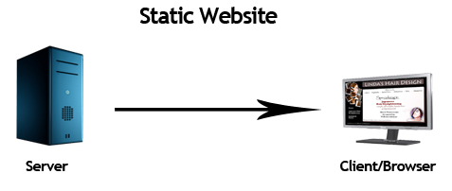
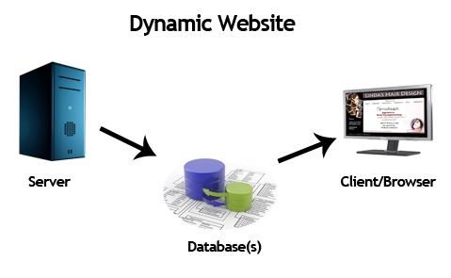
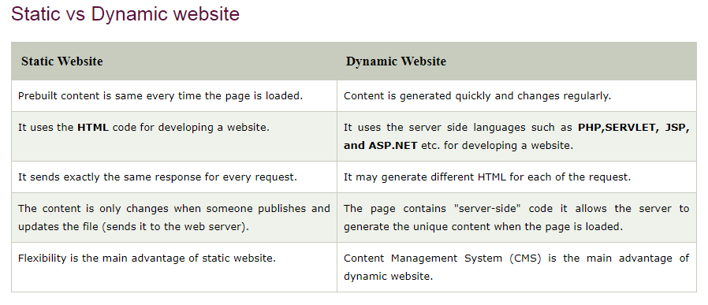

Slide 6
HTTP Requests
The request sends by the computer to a web server that contains all sorts of potentially interesting information is known as HTTP requests.
The HTTP client sends the request to the server in the form of request message which includes following information:
The Request-line
The analysis of source IP address, proxy and port
The analysis of destination IP address, protocol, port and host
The Requested URI (Uniform Resource Identifier)
The Request method and Content
The User-Agent header
The Connection control header
The Cache control header
The HTTP request method indicates the method to be performed on the resource identified by the Requested URI (Uniform Resource Identifier). This method is case-sensitive and should be used in uppercase.
The HTTP request methods are:

Slide 7
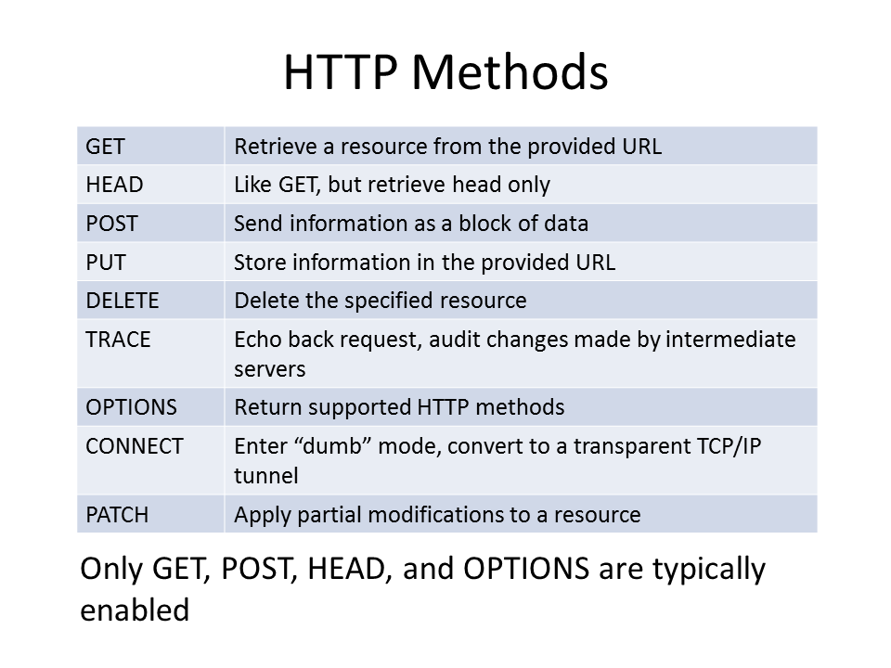
What are the HTTP Methods?

Slide 8
GET and POST
Two common methods for the request-response between a server and client are:
GET- It requests the data from a specified resource
POST- It submits the processed data to a specified resource
Anatomy of Get Request
The query string (name/value pairs) is sent inside the URL of a GET request:
GET /RegisterDao.jsp?name1=value1&name2=value2
As we know that data is sent in request header in case of get request. It is the default request type. Let's see what information is sent to the server.

Slide 9
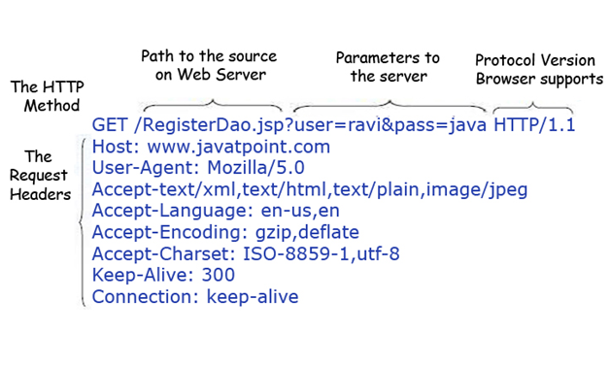
Features of GET requests are:
It remains in the browser history
It can be bookmarked
It can be cached
It have length restrictions
It should never be used when dealing with sensitive data
It should only be used for retrieving the data

Slide 10
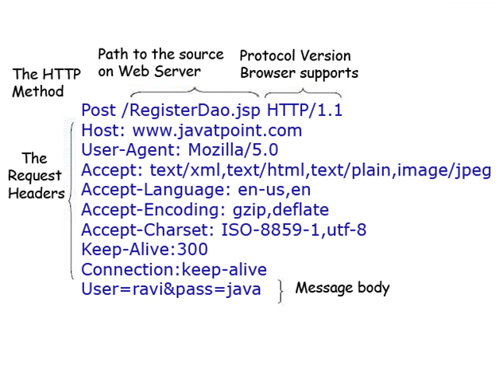
Anatomy of Post Request
The query string (name/value pairs) is sent in HTTP message body for a POST request:
POST/RegisterDao.jsp HTTP/1.1
Host: www. javatpoint.com
name1=value1&name2=value2
As we know, in case of post request original data is sent in message body. Let's see how information is passed to the server in case of post request.
Some other features of POST requests are:
This requests cannot be bookmarked
This requests have no restrictions on length of data
This requests are never cached
This requests do not remains in the browser history

Slide 11
What is a Servlet?
Servlet technology is used to create web application (resides at server side and generates dynamic web page) using Java Technology.
Servlet technology is robust and scalable because of java language. Before Servlet, CGI (Common Gateway Interface) scripting language was popular as a server-side programming language. But there was many disadvantages of this technology.
There are many interfaces and classes in the servlet API such as Servlet, GenericServlet, HttpServlet, ServletRequest, ServletResponse etc.
What is a Servlet?
Servlet can be described in many ways, depending on the context.
Servlet is a technology i.e. used to create web application.
Servlet is an API that provides many interfaces and classes including documentations.
Servlet is an interface that must be implemented for creating any servlet.
Servlet is a class that extend the capabilities of the servers and respond to the incoming request. It can respond to any type of requests.
Servlet is a web component that is deployed on the server to create dynamic web page.

Slide 12
Servlet API
Interfaces in javax.servlet package
Classes in javax.servlet package
Interfaces in javax.servlet.http package
Classes in javax.servlet.http package
The javax.servlet and javax.servlet.http packages represent interfaces and classes for servlet API.
The javax.servlet package contains many interfaces and classes that are used by the servlet or web container. These are not specific to any protocol.
The javax.servlet.http package contains interfaces and classes that are responsible for http requests only.
Let's see what are the interfaces of javax.servlet package.

Slide 13
Interfaces in javax.servlet package: There are many interfaces in javax.servlet package. They are as follows:
Servlet
ServletRequest
ServletResponse
RequestDispatcher
ServletConfig
ServletContext
SingleThreadModel
Filter
FilterConfig
FilterChain
ServletRequestListener
ServletRequestAttributeListener
ServletContextListener
ServletContextAttributeListener

Slide 14
Classes in javax.servlet package
There are many classes in javax.servlet package. They are as follows:
GenericServlet
ServletInputStream
ServletOutputStream
ServletRequestWrapper
ServletResponseWrapper
ServletRequestEvent
ServletContextEvent
ServletRequestAttributeEvent
ServletContextAttributeEvent
ServletException
UnavailableException

Slide 15
Interfaces in javax.servlet.http package
There are many interfaces in javax.servlet.http package. They are as follows:
HttpServletRequest
HttpServletResponse
HttpSession
HttpSessionListener
HttpSessionAttributeListener
HttpSessionBindingListener
HttpSessionActivationListener
HttpSessionContext (deprecated now)

Slide 16
Classes in javax.servlet.http package
There are many classes in javax.servlet.http package. They are as follows:
HttpServlet
Cookie
HttpServletRequestWrapper
HttpServletResponseWrapper
HttpSessionEvent
HttpSessionBindingEvent
HttpUtils (deprecated now)

Slide 17
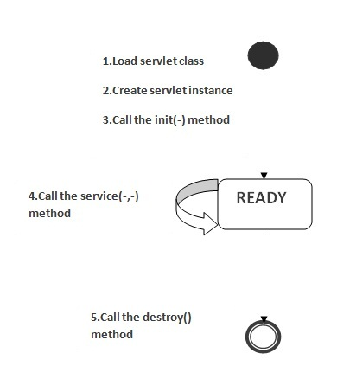
Life Cycle of a Servlet
The web container maintains the life cycle of a servlet instance. Let's see the life cycle of the servlet:
Servlet class is loaded
Servlet instance is created
init method is invoked
service method is invoked
destroy method is invoked
There are three states of a servlet: new, ready and end. The servlet is in new state if servlet instance is created. After invoking the init() method, Servlet comes in the ready state. In the ready state, servlet performs all the tasks. When the web container invokes the destroy() method, it shifts to the end state.

Slide 18
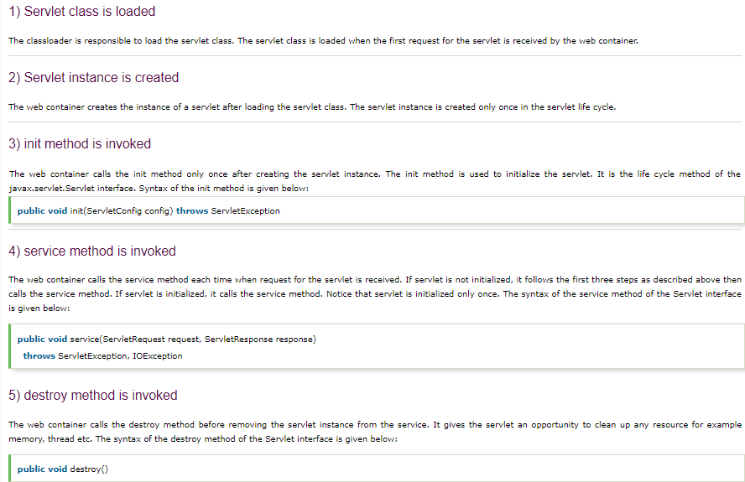

Slide 19
Steps to create a servlet example
There are given 6 steps to create a servlet example. These steps are required for all the servers. The servlet example can be created by three ways:
By implementing Servlet interface,
By inheriting GenericServlet class, (or)
By inheriting HttpServlet class
The mostly used approach is by extending HttpServlet because it provides http request specific method such as doGet(), doPost(), doHead() etc.
Here, we are going to use Apache Tomcat server in this example.
The steps are as follows:
Create a directory structure
Create a Servlet
Compile the Servlet
Create a deployment descriptor
Start the server and deploy the project
Access the servlet

Slide 20
War File
A WAR (web archive) File contains files of a web project. It may have servlet, xml, jsp, image, html, css, Javascript etc. files.
What is war file?
web archive (war) file contains all the contents of a web application. It reduces the time duration for transferring file.
Advantage of war file
saves time: The war file combines all the files into a single unit. So it takes less time while transferring file from client to server.
How to create war file?
To create war file, you need to use jar tool of JDK. You need to use -c switch of jar, to create the war file.
Go inside the project directory of your project (outside the WEB-INF), then write the following command:
jar -cvf projectname.war *
Here, -c is used to create file, -v to generate the verbose output and -f to specify the arhive file name.
The * (asterisk) symbol signifies that all the files of this directory (including sub directory).

Slide 21
How to deploy the war file?
There are two ways to deploy the war file.
By server console panel
By manually having the war file in specific folder of server.
If you want to deploy the war file in Apache Tomcat server manually, go to the webapps directory of apache tomcat and paste the war file here.
Restart the Apache Tomcat server
Now, you are able to access the web project through browser.
Note: server will extract the war file internally.
How to extract war file manually?
To extract the war file, you need to use -x switch of jar tool of JDK. Let's see the command to extract the war file.
jar -xvf projectname.war

Slide 22
welcome-file-list in web.xml
The welcome-file-list element of web-app, is used to define a list of welcome files. Its sub element is welcome-file that is used to define the welcome file.
A welcome file is the file that is invoked automatically by the server, if you don't specify any file name.
By default server looks for the welcome file in following order:
welcome-file-list in web.xml
index.html
index.htm
index.jsp
If none of these files are found, server renders 404 error.
If you have specified welcome-file in web.xml, and all the files index.html, index.htm and index.jsp exists, priority goes to welcome-file.
If welcome-file-list entry doesn't exist in web.xml file, priority goes to index.html file then index.htm and at last index.jsp file

Slide 23
First "Hello-world" Servlet
Let us begin by writing a servlet that says hello in response to a client's request. We shall use JDK and Tomcat to understand the basics, instead of IDE such as Eclipse/NetBeans. Once you understand the basics, you should use Eclipse/NetBeans to develop your webapp for better productivity.
Create a new Webapp "servletapps"
We shall begin by defining a new webapp (web application) called " servletapps" in Tomcat. A webapp, known as a web context in Tomcat, comprises a set of resources, such as HTML files, CSS, JavaScript, images, programs and libraries.
A Java webapp has a standardized directory structure for storing various types of resources.

Slide 24
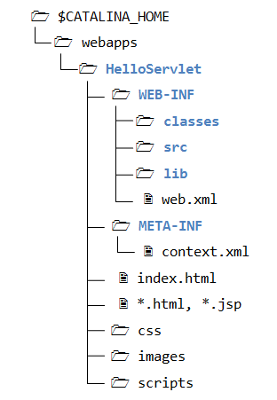

Slide 25
Create a directory "servletapp" under Tomcat's "webapps" directory (i.e., "<TOMCAT_HOME>\webapps\servletapp", where <TOMCAT_HOME> denotes Tomcat's installed directory). Create sub-directories "WEB-INF" and "META-INF" under "servletapp". Create sub-sub-directories "classes", "lib" and "src" under "WEB-INF". Take note that the directory names are case-sensitive.
The resources must be kept in the respective directories:
<TOMCAT_HOME>\webapps\servletapp: This directory is known as context root for the web context "servletapp". It contains the resources that are accessible by the clients, such as HTML, CSS, Scripts and images. These resources will be delivered to the clients as it is. You could create sub-directories such as images, css and scripts, to further categories the resources.
<TOMCAT_HOME>\webapps\servletapp\WEB-INF: This directory is NOT accessible by the clients directly. This is where you keep your application-specific configuration files (such as "web.xml"), and its sub-directories contain program classes, source files, and libraries.
<TOMCAT_HOME>\webapps\servletapp\WEB-INF\src: Keep the Java program source files. It is a good practice to separate the source files and classes to facilitate deployment.
<TOMCAT_HOME>\webapps\servletapp\WEB-INF\classes: Keep the Java classes (compiled from the source codes). Classes defined in packages must be kept according to the package directory structure.
<TOMCAT_HOME>\webapps\servletapp\WEB-INF\lib: keep the JAR files provided by external packages, available to this webapp only.
<TOMCAT_HOME>\webapps\servletapp\META-INF: This directory is also NOT accessible by the clients. It keeps resources and configurations (e.g., "context.xml") related to the particular server (e.g., Tomcat, Glassfish). In contrast, "WEB-INF" is for resources related to this webapp, independent of the server.

Slide 26
Write a Hello-world Java Servlet - "HelloServlet.java"
Servlets are Java programs that runs inside a Java-capable HTTP server. A user can invoke a servlet by issuing a specific URL from the browser (HTTP client). In this example, we shall write a servlet called "HelloServlet.java" and compiled into "HelloServlet.class". A client can invoke "HelloServlet.class" by issuing URL http://hostname:port/servletapp/sayhello (i.e., "sayhello" relative to the webapp).
A servlet shall be kept inside a Java package (instead of the default no-name package) for proper deployment. Let's call our package "mypack". Create a sub-directory called "mypack" under "WEB-INF\src". Use a programming text editor to enter the following source codes, and save as "HelloServlet.java" in "<TOMCAT_HOME>\webapps\servletapp\WEB-INF\src\mypack".
Details.txt

Slide 27
Java Servlets
A typical Java servlet (as shown below) contains three groups of methods: init(), destroy(), and one or more service() methods such as doGet() and doPost().
init() runs (once) when the servlet is loaded into the server.
destroy() runs (once) when the servlet is unloaded.
service() runs once per HTTP request (e.g., doGet() runs once per GET request, doPost() run once per POST request).
The service() methods takes two arguments: request and response, encapsulating HTTP request and response messages respectively.
A PrintWriter object called out is used for writing out the response message to the client over the network.
MyServlet.java

Slide 28
Compiling the Servlet (DIFFICULT)
We need the Servlet API to compile the servlet. Servlet API is NOT part of JDK. Nonetheless, Tomcat provides a copy in <TOMCAT_HOME>/lib/servlet-api.jar. We need to include this JAR file in the compilation via the -cp (classpath) option.
(For Windows)
// Assume that Tomcat is installed in C:\apache-tomcat-8.0.50\
// Change directory to the Java source directory
c:
cd C:\apache-tomcat-8.0.50\webapps\servletapp\WEB-INF\
// Compile
javac -cp .;"c:\apache-tomcat-8.0.50\lib\servlet-api.jar" HelloServlet.java
c:\<TOMCAT_HOME>\webapps\servletapp\WEB-INF> javac -d classes src\mypack\HelloServlet.java // --------- If you set classpath for servlet-api.jar
(The output of the compilation is "HelloServlet.class". Browse the "classes" folder to make sure that it is created.

Slide 29
Configure the Application Deployment Descriptor - "web.xml"
A web user invokes a servlet, which is kept in the web server, by issuing a specific URL from the browser.
In this example, we shall configure the following request URL to trigger the "HelloServlet":
http://hostame:port/helloservlet/sayhello
Create a configuration file called "web.xml", and save it under "webapps\servletapp\WEB-INF", as follows:
web.xml
The "web.xml" is called web application deployment descriptor. It provides the configuration options for that particular web application, such as defining the the mapping between URL and servlet class.
The above configuration defines a servlet named "HelloWroldServlet", implemented in "mypkg.HelloServlet.class" (written earlier), and maps to URL "/sayhello", where "/" denotes the context root of this webapp "servletapp". In other words, the absolute URL for this servlet is http://hostname:port/servletapp/sayhello.
Take note that EACH servlet requires a pair of <servlet> and <servlet-mapping> elements to do the mapping, via an arbitrary but unique <servlet-name>. Furthermore, all the <servlet> elements must be grouped together and placed before the <servlet-mapping> elements (as specified in the XML schema).

Slide 30
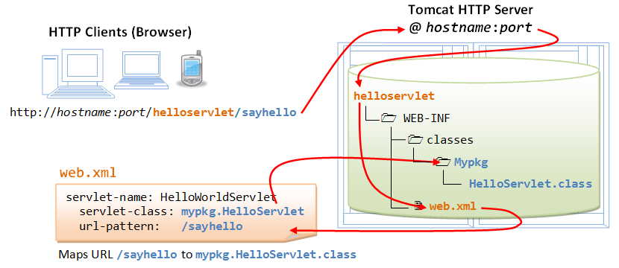

Slide 31
Run the Hello-world Servlet
To run the servlet, first start the Tomcat server. Verify that the web context "servletapp" has been deployed by observing the following messages in the Tomcat's console:
xxx x, xxxx xx:xx:xx xx org.apache.catalina.startup.HostConfig deployDirectory
INFO: Deploying web application directory helloservlet
......
Start a web browser (Firefox, IE or Chrome), and issue the following URL (as configured in the "web.xml").
Assume that Tomcat is running in port number 8080.
http://localhost:8080/servletapp/sayhello
We shall see the output "Hello, world!".
Try selecting "View Source" in your browser, which produces these output:

Slide 32
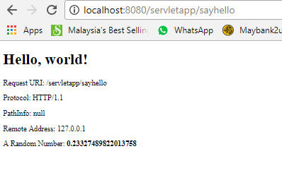

Slide 33
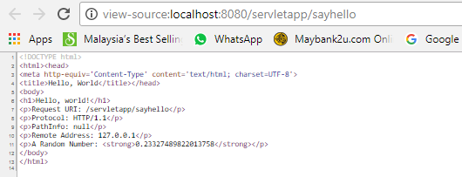
It is important to take note that users receive the output of the servlet. User does not receive the servlet's program codes, which are kept under a hidden directory "WEB-INF" and not directly accessible by web users.

Slide 34
Creating Servlet Example in Eclipse
Eclipse is an open-source ide for developing Java SE and Java EE (J2EE) applications. You need to download the eclipse ide for JavaEE developers.
Creating servlet example in eclipse ide, saves a lot of work to be done. It is easy and simple to create a servlet example. Let's see the steps, you need to follow to create the first servlet example.
Create a Dynamic web project
Create a package under Java Resources/src/
Create a servlet
Add servlet-api.jar file
Run the servlet
Refer: Servlets_Using_Eclipse.docx

Slide 35
Run Tomcat from Eclipse
Why set up and run Apache Tomcat 8 from Eclipse IDE?
First you can debug your applications directly, without running Tomcat stand-alone server in debug mode.
Second you can run JUnit tests on your app before deploying it.
Third you can deploy your apps directly from Eclipse.
1. In Eclipse for Java EE go to Window => Preferences in Windows OS.
2. Go to Server and click Runtime Environments.
3. Click the “Add….” button.
4. In Apache tree select Tomcat 8 and check the checkbox “Create a new local server”.
5. On the next screen click “Browse….” and select your Tomcat installation directory. In the JRE drop-down select your local Java 8 SE Installation and confirm by clicking the “Finish” button.
Tip: Eclipse will use a built-in browser to open your web-apps. You can change this setting to a more convenient browser like Google Chrome or Firefox. To do this go to Window -> Web Browser and select “Default system web browser”

Slide 36
Create WebApps and Run Servlets from Eclipse
Go to File, New, Select Dynamic Web Projects
Create a dynamic Web Project in Eclipse and assign the name of project as MyWebapps.
Create a package
Select project, Go Java Resources, Select src New, package, name it as “com.gopi.jee”
Create a HTML file
Select project, New, HTML file
Now create a HTML file inside WebContent directory of your project and provide the name of HTML file as querybook.html.
It must created under WebContent folder under context root MyWebapps. Confirm.
Edit querybook.html for <form method="get" action="http://localhost:8080/MyWebapps/query">
Create a Servlet
Now create a package com.gopi.jee and in that package create a class QueryServlet.java and add code into this. This servlet class receives all the data entered by user and stores it into the database.

Slide 37
Add following code in web.xml.
<servlet>
<servlet-name>UserQuery</servlet-name>
<servlet-class>com.gopi.jee.QueryServlet</servlet-class>
</servlet>
<servlet-mapping>
<servlet-name>UserQuery</servlet-name>
<url-pattern>/query</url-pattern>
</servlet-mapping>
Select File , Save ALL

Slide 38
Processing HTML Form Data
4.1 Write an HTML Form
HTML provides a <form>...</form> tag, which can be used to build a user input form containing elements such as text fields, password field, radio buttons, pull-down menu, checkboxes, text area, hidden field, submit and reset buttons. This allows web users to interact with the web server by submit data. For example,
Create the following HTML script, and save as "form_input.html" under the context root "servletapp".
form_input.html
Start the tomcat server. Issue the following URL to request for the HTML page:
http://localhost:8080/helloservlet/form_input.html
form_explanation.txt

Slide 39
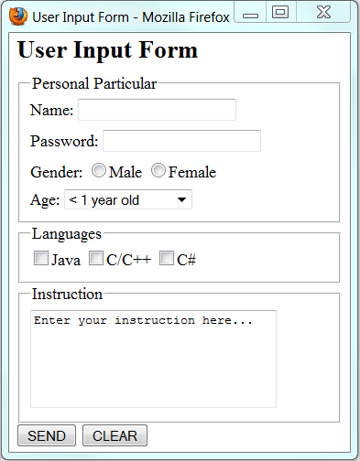

Slide 40
Write a Servlet to Process Form Data - "EchoServlet.java"
The form that we have written send its data to a server-side program having relative URL of "echo" (as specified in the action="url" attribute of the <form> start-tag). Let us write a servlet called EchoServlet, which shall be mapped to the URL "echo", to process the incoming form data. The servlet simply echoes the data back to the client.
Similar to the "HelloServlet", we define the "EchoServlet" under package "mypack", and save the source file as "<TOMCAT_HOME>\webapps\servletapp\WEB-INF\src\mypack\EchoServlet.java".
Configure the Servlet URL mapping in "web.xml"
Our <form>'s action attribute refers to relative URL "echo", which has to be mapped to the EchoServlet.class in the web application deployment descriptor file "WEB-INF\web.xml":
web.xml
Run the EchoServlet
Start the Tomcat server. Issue URL
http://localhost:8080/helloservlet/form_input.html.
Fill up the form, click the submit button to trigger the servlet.

Slide 41
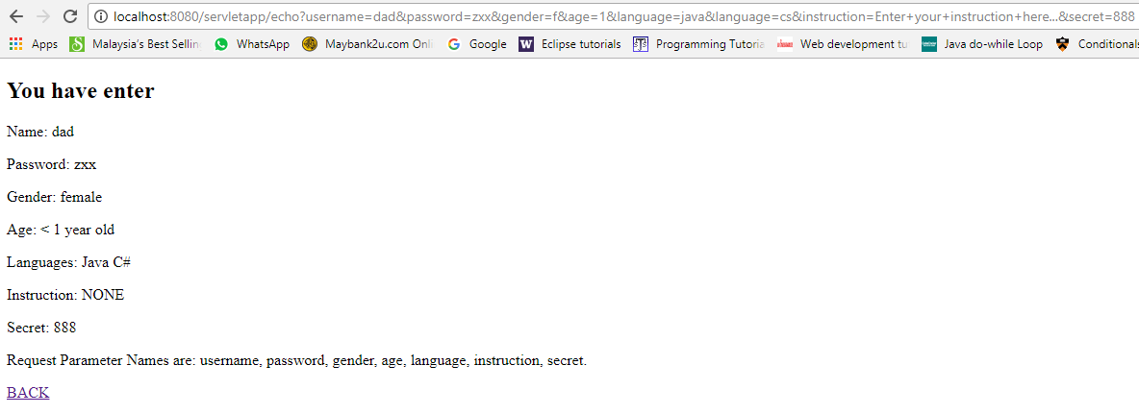

Slide 42
Form-Data Submission Methods: GET|POST
Two request methods, GET and POST, are available for submitting form data, to be specified in the <form>'s attribute "method=GET|POST". GET and POST performs the same basic function. That is, gather the name-value pairs of the selected input elements, URL-encode, and pack them into a query string. However, in a GET request, the query string is appended behind the URL, separated by a '?'. Whereas in a POST request, the query string is kept in the request body (and not shown in the URL). The length of query string in a GET request is limited by the maximum length of URL permitted, whereas it is unlimited in a POST request. I recommend POST request for production, as it does not show the strange looking query string in the URL, even if the amount of data is limited. In this tutorial, I use GET method, so that you can inspect the query string on the URL.
To try out the POST request, modify the "form_input.html":
<form method="post" action="echo">
......
</form>
Inside the servlet, GET request is processed by the method doGet(), while POST request is processed by the method doPost(). Since they often perform identical operations, we re-direct doPost() to doGet() (or vice versa), as follows:

Slide 43
public class MyServlet extends HttpServlet {
// doGet() handles GET request
@Override
public void doGet(HttpServletRequest request, HttpServletResponse response)
throws IOException, ServletException {
......
......
}
// doPost() handles POST request
@Override
public void doPost(HttpServletRequest request, HttpServletResponse response)
throws IOException, ServletException {
doGet(request, response); // call doGet()
}
}

Slide 44
Configure MySQL JDBC driver for Eclipse
Select the project MyWebapps, right click select Build Path, Select Configure Build Path.
Select Library, Click on Add External jar, browse to location where MySQL JDBC driver is stored. Apply, apply and close.
Shutdown the Apache Tomcat if running outside the Eclipse.
In Eclipse Select the project MyWebapps, right click select Run As server,
Browser will be opened and will display directory and querybook.html.
Click on querybook.html and proceed further.

Slide 45
Write a Database Servlet
Step 7(a) Setup a Database on MySQL (Already done in the MySQL exercises)
Start your MySQL server. Take note of the server's port number. I shall assume that the MySQL server is running on port 3306 (whereas the Tomcat is running on port 9999).
// For Windows: I shall assume that MySQL is installed in "c:\myWebProject\mysql"
c:
cd \myWebProject\mysql\bin
mysqld --console
Start a MySQL client. I shall assume that there is a user called "myuser" with password "xxxx".
// For Windows: I shall assume that MySQL is installed in "c:\myWebProject\mysql"
c:
cd \myWebProject\mysql\bin
mysql -u myuser -p

Slide 46
Run the following SQL statements to create a database called "ebookshop", with a table called "books" with 5 columns: id, title, author, price, qty.
create database if not exists ebookshop;
use ebookshop;
drop table if exists books;
create table books (
id int,
title varchar(50),
author varchar(50),
price float,
qty int,
primary key (id));
insert into books values (1001, 'Java for dummies', 'Tan Ah Teck', 11.11, 11);
insert into books values (1002, 'More Java for dummies', 'Tan Ah Teck', 22.22, 22);
insert into books values (1003, 'More Java for more dummies', 'Mohammad Ali', 33.33, 33);
insert into books values (1004, 'A Cup of Java', 'Kumar', 55.55, 55);
insert into books values (1005, 'A Teaspoon of Java', 'Kevin Jones', 66.66, 66);
select * from books;

Slide 47
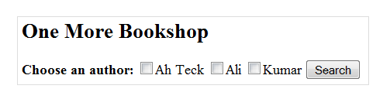
Step 7(b) Install MySQL JDBC Driver
Step 7(b) Install MySQL JDBC Driver
(Already done in the previous JDBC exercises)
You need to download MySQL JDBC driver if you have not done so.
Step 7(c) Copy the MySQL JDBC Drive to Tomcat's "lib" (IMPORTANT!!!)
Copy the MySQL JDBC Driver JAR file "mysql-connector-java-5.1.{xx}-bin.jar" into Tomcat's lib directory, i.e., " C:\apache-tomcat-8.0.50\lib" (for Windows)
Step 7(d) Write a Client-side HTML Form
Let's write an HTML script to create a query form with 3 checkboxes and a submit button, as illustrated below. Save the HTML file as “querybook.html” in your application root directory “<TOMCAT_HOME>\webapps\servletapp”.
querybook.html

Slide 48
You can browse the HTML page by issuing the following URL:
http://localhost:8080/servletapp/querybook.html
Check a box (e.g., "Tan Ah Teck") and click the "Search" button. An HTTP GET request will be issued to the URL specified in the <form>'s "action" attribute. Observe the URL of the HTTP GET request:
http://localhost:8080/servletapp/query?author=Tan+Ah+Teck
The request consists of two part: a URL corresponding to the "action" attribute of the <form> tag, and the "name=value" pair extracted from the <input> tag, separated by a '?'. Take note that blanks are replaced by '+' (or %20), because blanks are not allowed in the URL.
If you check two boxes (e.g., "Tan Ah Teck" and "Mohammad Ali"), you will get this URL, which has two "name=value" pairs separated by an '&'.
http://localhost:8080/servletapp/query?author=Tan+Ah+Teck&author=Mohammad+Ali
You are expected to get an error "404 File Not Found", as you have yet to write the server-side program.

Slide 49
Step 7(e) Write the Server-side Database Query Servlet
The next step is to write a Java servlet, which responses to the client’s request by querying the database and returns the query results.
Save QueryServlet.java under C:\apache-tomcat-8.0.50\webapps\servletapp\WEB-INF\src\mypack
QueryServlet.java
Compile "QueryServlet.java" as follows:
// Windows
c: // Change drive
cd <TOMCAT_HOME>\webapps\servletapp\WEB-INF\ // Change directory to Java Source directory
javac -cp .;" <TOMCAT_HOME>\ lib\servlet-api.jar" QueryServlet.java // Compile
Javac –d classes src\mypack\QueryServlet.java // classpath set for servlet-api.jar

Slide 50
Step 7(f) Configure the Request URL for the Servlet
Open the configuration file "web.xml" of your application “servletapp" that you have created earlier for the HelloServlet, i.e., "<TOMCAT_HOME>\webapps\servletapp\WEB-INF\web.xml".
Add the lines that are shown in red at the LOCATIONS INDICATED.
<servlet>
<servlet-name>UserQuery</servlet-name>
<servlet-class>mypack.QueryServlet</servlet-class>
</servlet>
<servlet-mapping>
<servlet-name>UserQuery</servlet-name>
<url-pattern>/query</url-pattern>
</servlet-mapping>
The above lines configure the following URL to invoke QueryServlet:
http://localhost:8080/servletapp/query

Slide 51
Step 7(g) Invoke the Servlet from the Client-Side Form
Issue the following URL to browse the HMTL form "querybook.html" that you have created earlier:
http://localhost:8080/servletapp/querybook.html
Select an author (e.g., "Tan Ah Teck") and click the submit button, which activates the following URL coded in the <form>'s "action" attribute, together with the name=value pair:
http://localhost:8080/servletapp/query?author=Tan+Ah+Teck
This URL "/query" triggers QueryServlet. The QueryServlet retrieves the name=value pair of "author=Tan+Ah+Teck". Inside the QueryServlet, the method request.getParameter("author") returns "Tan Ah Teck", which is inserted into the SQL SELECT command to query the database. The processed query result is then written to the client as an HTML document.

Slide 52
Deploying Servlet using @WebServlet
Servlet 3.0, which is supported by Tomcat 7 onwards, introduces the @WebServlet annotation, which greatly simplifies the deployment of servlets. You no longer need to write the deployment descriptor in "web.xml".
Instead, you can use the @WebServlet annotation to specify the URL mapping.
For example, let us write a new servlet called AnotherHelloServlet.java, by modifying the HelloServlet.java written earlier, with URL mapping of "sayhi".
AnotherHelloServlet.java
In Line 7, the annotation @WebServlet("/sayhi") is used to declare the URL mapping for this servlet, i.e., http://localhost:8080/servletapp/sayhi. There is no need to provide any more configuration in "web.xml"!

